Slide 1

Intern abroad
We accept and deliver young people through intern programs.
Through the process of solving social problems , young students will make opportunities to explore and develop their leadership , expertise and ambition involving companies/local non-profit/administrations.
Outgoing exchange
Japanese students work at overseas non-profit or companies
Incoming exchange
Overseas students work at Japanese non-profit or companies.
Program focusing on internships
Through the internship
1
2
3
Our goal is to get leadership, expertise, and ambition at the process of approaching to the social problems.
Before internship
While internship
After internship
Students learn about social problems which they are interested in with companies approaching to the social problems.
Students approach to the social problems through practical actions based on the preparations.
Students transmit their experiences for the world to influence society.
expertise
leadership
ambition
2

Slide 2
Concept
Diversity
From now on, diversity of people is accelerating in Japanese society.
Today, social situation around japan and the world needs society that varies people coexist regardless of ages, gender, nationality and personality, giving examples such as aging, the gap between rich and poor, prosperity of the tourist industry and social attention to foreign worker and LGBT.
We want to solve that social problem, and make the society that everyone live happily. In addition, young people who will bear the next generation such as us need to act more on its initiative in promoting diversity.
We made this program because we wanted to create the internship that promote Japanese diversity with young people in the world and various companies/organizations.
3

Slide 3
Society problem to solve
We promote a better society that LGBT can be lively-full of life
Cooperation with Shibuya ward office
Cooperation with students all over the world
LGBT with a low degree of recognition
Aoyama University cooperation with Shibuya ward office that has a first decision to recognize same-sex partnerships in japan. We think there are things which can be only we can do.
AIESEC is the largest student group in the world. We take advantage of our group size and seek for student who want to improve LGBT problem,come from a LGBT sympathetic advanced nation.
The interest in LGBT increase rapidly all over the world. However,the interest in LGBT in Japan is low. We want to raise interest in LGBT in Japan more.
4

Slide 4
Society problem to solve
Six domains where Japanese people feel a disorder
Home
Field of education
Employment/Workplace
Medical
Marriage
Public service
To solve the home problem and the field of education problem in LGBT
Essence of the problem that
people concerned have
Usefulness of the activity
by the student
I think that one of the prime cause that LGBT feels an obstacle in life and feels pain mentally is environment in the child times.
From the situation called a student standing between education and working, I can approach two domains in a closer viewpoint.
5

Slide 5
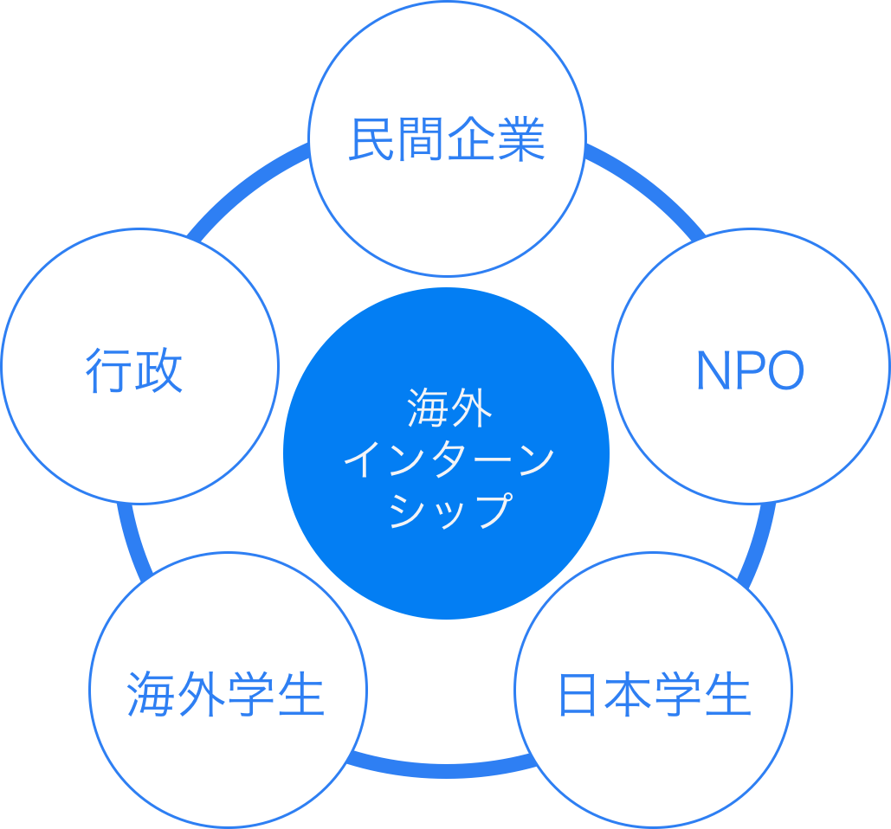


Our TN and Partners
Society × Global × Youth leader
LITALICO Inc.
We involve every social domain such as Private enterprise/ NPO/ Administration
and design the internship to affect the society more widely. Furthermore, we will spread this movement from AIESEC Japan to a bigger impact in global.
We collaborate with one of the most famous Japanese social venture company LITALICO Inc. as a TN,
for problem solution in education and employment of LGBT and deepen the learning for EP.
Shibuya city office
NPO SHIBUYA Uni.
We have a strong back up by the government, they supports us for public relations to the whole Shibuya city.
We have the tie-ups by supported the knowledge side about the specific issue. Also we will collaborate for an event.
EP
AGLC in Japan
EP from the LGBT developed country (including China, Thai, Europe) participates to this program. By bringing the study from own country, and bring back the learning in Japan.
Planning this program, we have responsibility for matching and delivery operations. We also support EP during the program.
6

Slide 6

3 themes of this program
ーThe social background surrounds LGBTー
Lack of the individuality
of LGBT selves
Lower recognition of
high school students
Unsuitable parent
understanding
Most of the LGBT endure their pain. It is necessary that LGBT person stands up and takes the leadership by oneself to create a society where LGBT could live their way they are.
LGBT person at puberty, it is the timing they referred to as the particular anguish. If the surrounded community become able to show understanding the diversity, there will be a lot of people saved.
Numbers of LGBT had a discriminatory experience in the childhood. In fact, less of them could open mind to their parent who should be nearest. If they shows understanding of LGBT it will lead to the relief of the child
NEXT LGBT Leaders
training
Think Diversity
at high school
Design a
Parents community
7

Slide 7
The content of internship①
◇The purpose of this internship
We create an opportunity interns can grow and be next generation LGBT leaders with Japanese students.
◇Target to approach
◇Cooperation partners
Raising next generation LGBT leaders
LGBTリーダー
の輩出
LGBT or students having
social conscious/strong independence
Shibuya ward office
Student groups of LGBT
1
2
3
Planning events with LITALICO
Marketing for publicity of events
Hearing from young LGBT leaders
Discussion to search means for solving problems about LGBT
LITALICO members, members of Shibuya ward office and aiesec members participate in this event
Call for the other NPO’s participation
Proposed the output of this event to LITALICO Shibuya ward office
We look for future efforts
◇Point
We approach, raise excellent human resources and aim that the intern causes social impact in the future.
8

Slide 8
The content of internship②
◇The purpose of this internship
We create the environment which high school students accept “Diversity” by thinking about “Diversity” included LGBT
Think about “Diversity” with
high school students
◇Target to approach
◇Cooperation partners
High school students in Shibuya
Shibuya ward office
High school in Shibuya
Rebit
1
2
3
Request for cooperation of high school through
Shibuya ward office‘s mediation
(before visiting Japan)
Planning classes with LITALICO
Hearing about LGBT education of high school students from Rebit
Special classes at high school in Shibuya
Explain the concept of “Diversity” the effort about it of LITALICO and Shibuya ward office
Open workshop which high school students think about “Diversity”
Take a video about this internship and delivery on the internet
Report this internship to Shibuya ward office
Shibuya ward office can make use of it for future effort
We approach high school students.
We aim to promote an expansion of LGBT permissible range by changing majority’s consciousness.
◇Point
9

